Slide 1
Module 13
Reflections, CBT and Scope of Practice

Slide 2
Agenda:
Student presentations
Overview of CBT
CBT writing activity
Discussion of scope of practice
Objectives:
Define cognitive behavioral therapy and describe its use in nutrition counseling
Outline reasons to and methods for referring clients to mental health professionals

Slide 3
Student Presentations:

Slide 4
Maria’s question and taking stock
I am wondering if you will be able to share the next class or latter classes, some of your very first experiments with counseling your clients, at the beginning of your career? What is the most difficult at the beginning, what is the most easier? What we have to know at the beginning, some secrets, etc? I think it will be great to know for everyone in the class, especially some people going to graduate soon, so we could know how the theory works on practice.
Confidence?
How to use our time to increase confidence?

Slide 5
Review from last week
Self Monitoring Client: “I think keeping track of what I eat is a good idea. Let’s do that.”
Personalized Structured Meal Plans Client: “What do you mean about collaborating on the meal plan?”
Problem Solving You have explained to your client HOW to keep a food record, what should you do next?
Collaborative Goal Setting Keep going, set a goal, together with your client, to overcome obstacles and follow through with keeping a food record for a week.
Cognitive Restructuring Pretend you discovered a cognitive barrier. Guess how you’d handle that.
Stimulus Control where, in the 4 phases of counseling, would this likely come up?

Slide 6
Review: supporting people to follow-through
Your client is ready to get away from endless yo-yo dieting.
You’ve already moved through the first 3 phases of MI and are confident that together you’ve discovered:
      Their (for now) motivating “why” or wish for doing things differently
      Their (for now) most important obstacles (They drink soda and alcoholic beverages socially, as a daily reward, and an afternoon “pick me up”. They don’t really enjoy to taste of plain water.)
      Different ideas for specific next steps they could take
    You’re ready to plan the first experiment. WOOP wish, why they want that, obstacles, plan if, then plan.
      Write example plans you and your client might create.
      Think through the counseling you’d do to arrive at these plans.

Slide 7
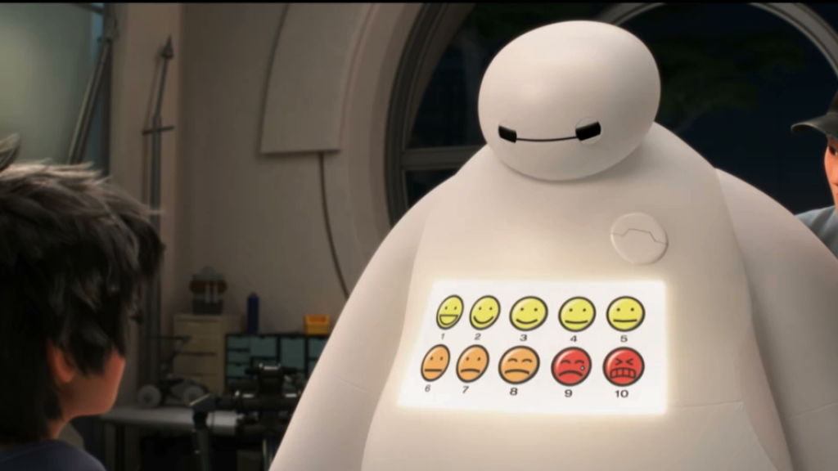
How likely is it that we will encounter clients whose eating problems stem from emotions?

Slide 8
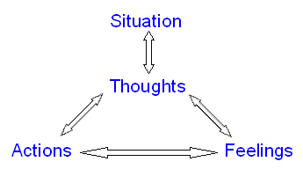
When thinking gets in the way

Slide 9
Cognitive-Behavioral Therapy
Cognitive behavioral therapy (CBT) is a technique for changing maladaptive thinking in ways that support changes in feelings and behavior.
Emphasis is on changes in one's relationship to maladaptive thinking rather than changes in thinking itself
How can people change the way they feel and respond to thoughts?
Cognitive behavioral therapy (CBT) overview: https://www.youtube.com/watch?v=bUOaHsxe8OQ

Slide 10
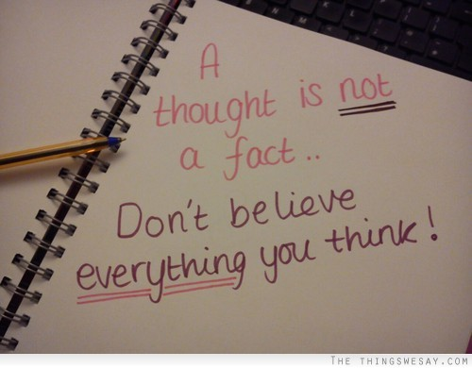

Slide 11

Cognitive-Behavioral Therapy
When something disturbing happens, people are often faced with two problems:
    a) what happened
    b) how they think and feel about what happened.
CBT supports taking a more open, mindful, and aware posture toward troubling thoughts

Slide 13
Start with Understanding
(Adapted from: Get gg Therapy Resources)
We cannot stop our thoughts, and we cannot control them.
Thoughts are messages from our brain. They are not necessarily true, and not necessarily helpful.
We can learn to react to thoughts differently.

Slide 14



Playground Bully Metaphor
Three ways to react to a bully and to a “hot” thought:

Slide 15
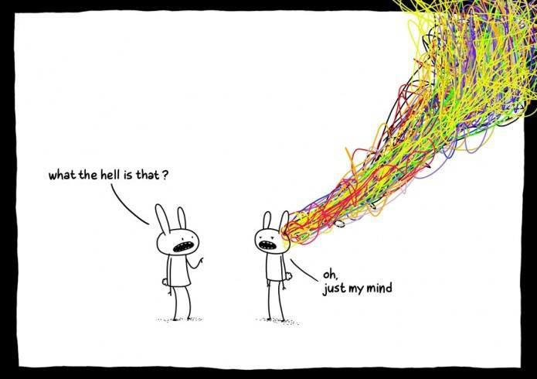
Certain core beliefs underlie most unhelpful emotions and behaviours:
1. I need love and approval from those around me.
2. I must avoid disapproval from any source.
To be worthwhile, I must be successful at
whatever I do.
4. I can not allow myself to make mistakes.
5. People should always do the right thing. When they behave obnoxiously, unfairly or selfishly, they must be blamed and punished.
6. Things must be the way I want them to be.
7. My unhappiness is caused by things that are outside my control – so there is nothing I can do to feel any better.

Slide 16
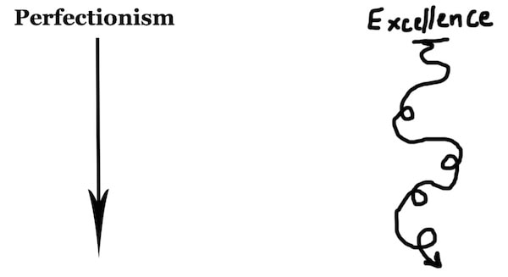
8. I must worry about things that could be dangerous, unpleasant or frightening – otherwise they might happen.
9. I must avoid life’s difficulties, unpleasantness, and responsibilities.
10. Everyone needs to depend on someone stronger than themselves.
11. Events in my past are the cause of my problems – and they continue to influence my feelings and behaviours now.
12. I should become upset when other people have problems, and feel unhappy when they’re sad.
13. I shouldn’t have to feel discomfort and pain.
14. Every problem should have an ideal solution.

Slide 17
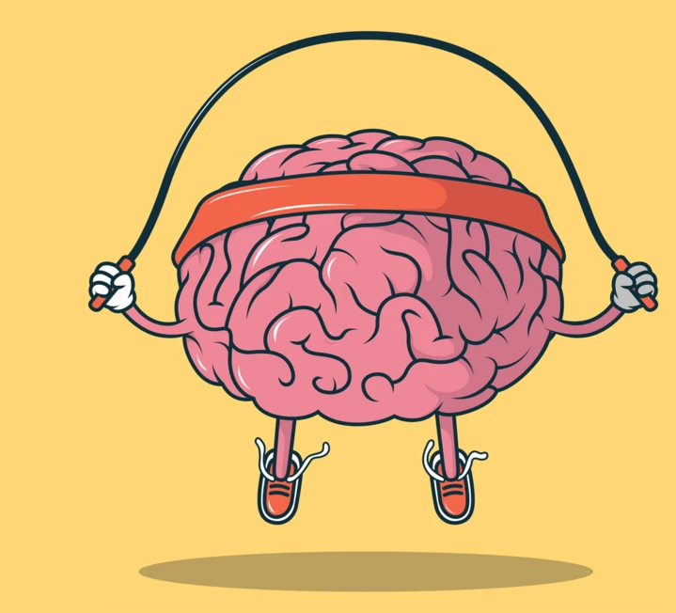
CBT Activity: what mindset could you or have you improved?
(jot down 3 things)

Slide 18
Nutrition & Irrational Beliefs we’ve encountered

Slide 19


Nutrition & Irrational Beliefs
Learned helplessness (nothing I do makes a difference)
Over using food or sweetened beverages to improve mental state
Rationalize exercise compensation
Most recent = always = catastrophizing
Slim happy start living life
Because my body isn’t perfect, I don’t deserve love and respect.
Future self = Super self (eat now and diet later)

Slide 20
Cognitive-Behavioral Therapy Interventions
ABC method: Have clients think about
(Activator/Trigger) what happened that started the client’s unproductive thoughts, feelings, and behaviors?
(Irrational Belief) what were the client’s thoughts and self talk?
(Consequence of believing the thought) what actions did the client take?
(Dispute the Irrational Belief) when this happens, what could the client thing or do instead?
(Effective new thinking) what would be a more productive overall perspective to have?

Slide 21

Unpacking & Checking for the Problem
What has this been like for you?
How do you cope with setbacks, stress, depressed mood, anxiety, emotions?
What strategies do you use to start feeling better?
Gauge use of food for coping.

Slide 22
When you suspect a self-talk/mindset problem
“Some of my clients have this critical ‘voice’ in their heads that says really mean things about food/body.”
“Tell me more about what goes on in these situations?”
Elicit and summarize: trigger situations, thoughts, feelings, behaviors
Elicit their response to your summary: “Do I have that right?”
Set goals to experiment to find methods to reduce unsuitable behaviors.

Slide 23

Some strategy ideas to add to brainstorming
Think of thoughts as bullies
Treat thoughts like they’re naughty puppies
Stop when you catch yourself entering a thought “monolog” or “spinning”
Keep an experience and thought journal (self monitor thoughts)
Reading
Work with a counselor trained in CBT

Slide 24
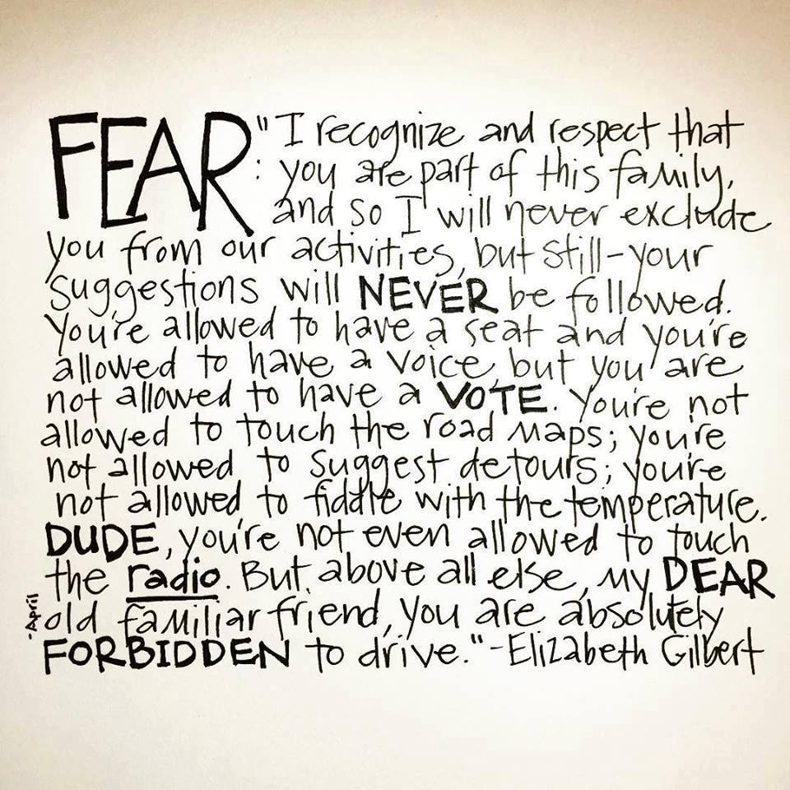

Slide 25
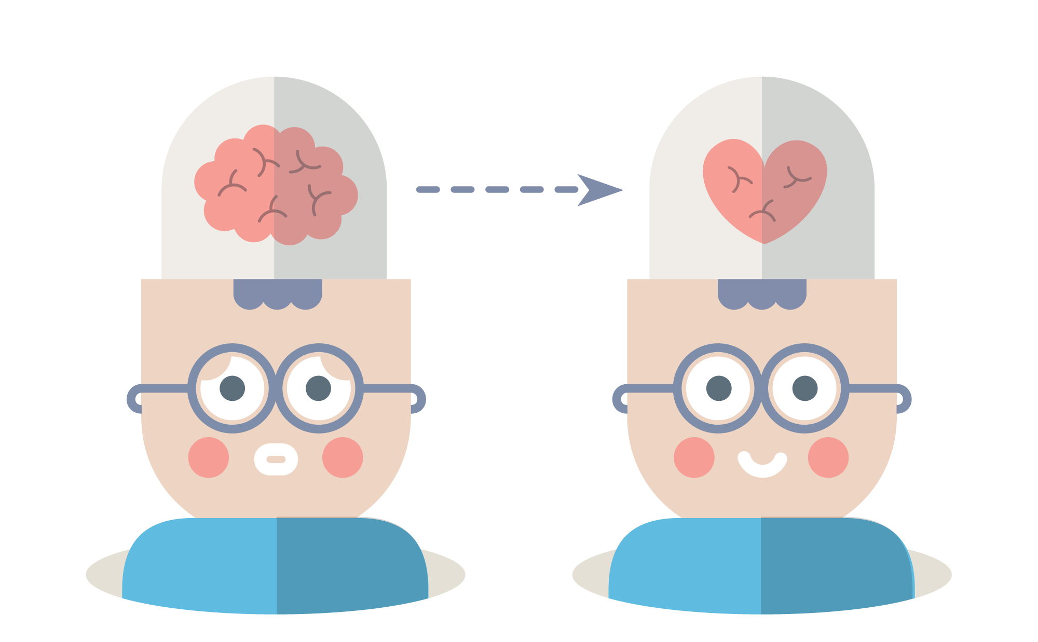
Long-term Goals of CBT
Use of strategies to cope with disturbing thoughts, emotions, and behaviours
A curious, growth-oriented mindset.
Eventual change in the underlying beliefs.
Client uses a variety of techniques that enable long-term coping in a variety of settings.

Slide 26
Scope of practice and Referrals
Ask, “What are the goals of the work to be done?”
Nutrition therapy targets medical conditions, food behaviors, and sometimes, a person’s relationship with food and body.
Psychotherapy targets mood, treating mental illness, healing from trauma, and relationships.

Slide 27
Scope of practice
Refer when:
• You spend sessions talking mostly about topics unrelated to food and nutrition
• You feel over your head

Slide 28
What you could say:
“What you said sounds really important and like it gets in the way of progress on your health goals.”
“It’s outside my role as a dietitian to help you work on that…I know several good therapists”
“What are your thoughts on working with and therapist and with me?”

